Slide 1
Breast cancer
Detection

Slide 2
Breast Cancer Detection using Machine Learning
Predicting Tumor Type: Benign or Malignant
Tools: Python – Pandas – numpy – Scikit-learn – Streamlit
Prepared by: Eman Mohamed Elnawawy and Mariam AbdelAziz

Slide 3
Table of Contents
1
2
3
4
Introduction
Dataset Overview
Data Preprocessing
Model Comparison
5
6
Model Tuning
Application InterfaceBuilt an interactive Streamlit app
8
7
Pipeline Overview
Conclusion

Slide 4

Introduction
Breast cancer is one of the most common cancers among women.
Early detection improves treatment success and survival rate.
Project goal: Build an AI model to predict if a tumor is Benign (non-cancerous) or Malignant (cancerous) using medical data

Slide 5
Dataset Overview
Source: Breast Cancer Wisconsin Dataset (scikit-learn)
Samples: 569
Features: 30 medical measurements
Target labels:
0 = Malignant (212 cases)
1 = Benign (357 cases)

Slide 6
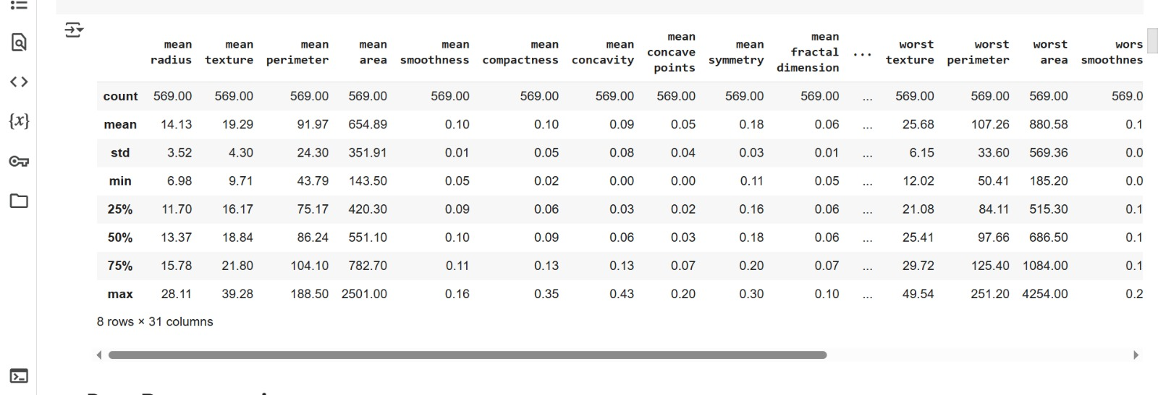

Slide 7
Data Preprocessing
Dropped unused column (target_names)
Split data:
X: all features
y: target label
Train/Test Split: 70% / 30%
Used StandardScaler to normalize features
Used stratify=y to preserve class distribution

Slide 8
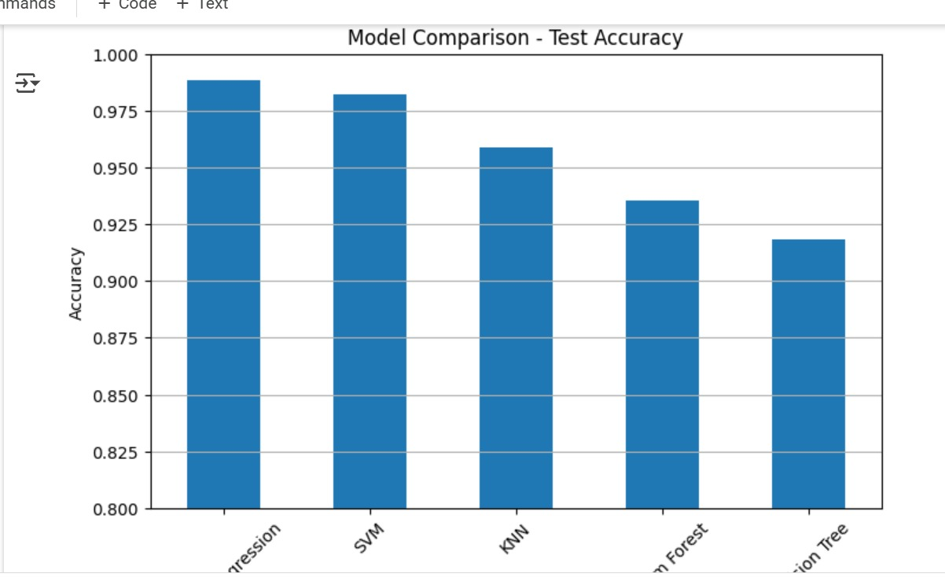
Best model: Logistic Regression
Accuracy evaluated on test set
Model Comparison

Slide 9
Model Comparison
Notes | Model
Fast, interpretable, best performer | Logistic Regression
Powerful but sensitive to outliers | SVM (Linear)
Distance-based, slower in testing | KNN
More stable than Decision Tree | Random Forest
Can overfit easily | Decision Tree

Slide 10
Model Tuning
Technique:Used GridSearchCV to find best C value for Logistic Regression
Best parameter: C = 1
Cross-validation accuracy: 0.9826
Final test accuracy: 0.9883
High precision, recall, and F1-score

Slide 11
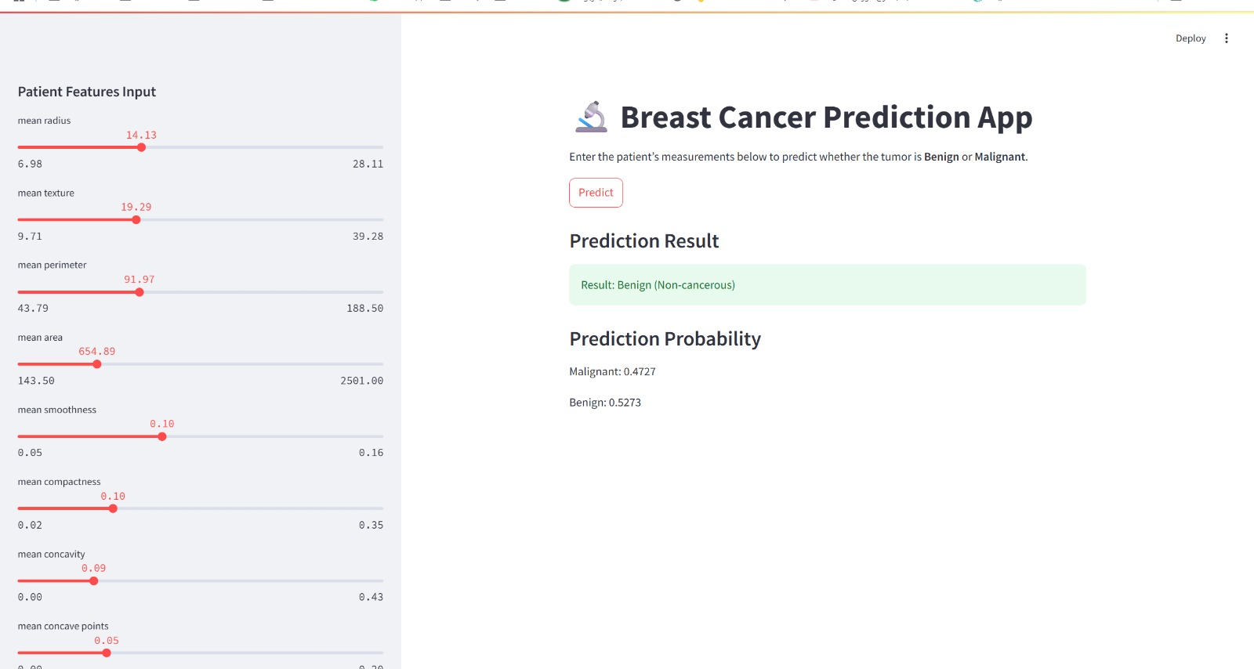
Application InterfaceBuilt an interactive Streamlit app
Built an interactive Streamlit app
Allows manual input of 30 feature values
On click "Predict":
Outputs result (Benign / Malignant)
Shows Prediction Probability

Slide 12
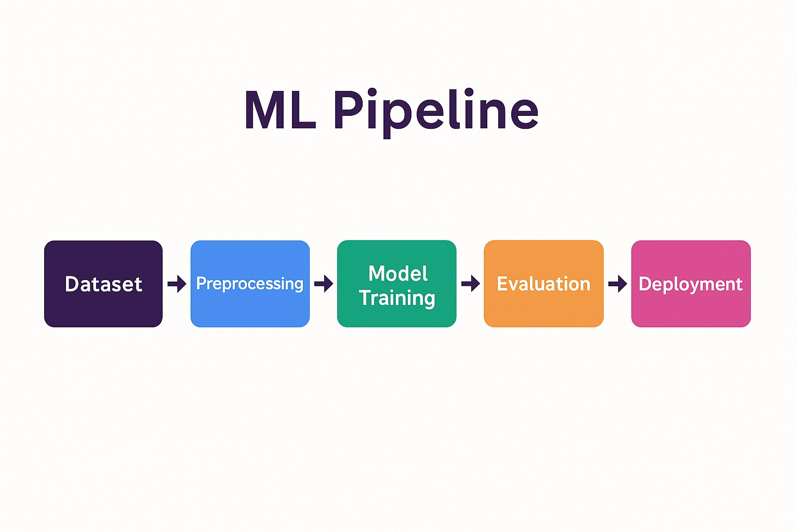
ML Pipeline

Slide 13
Conclusion
The project shows:
Simple models like Logistic Regression can be highly effective
Clean preprocessing and model tuning are key
Streamlit allows rapid app deployment for real use

Slide 14
Thank you

